Slide 1








HAHAHA Western
Restaurant
By:Group HAHAHA
SMJK PHOR TAY

Slide 2





TEAM MEMBER
Tan Hui En
Lim Yee Wen
Janelle Fong

Slide 3







INTRODUCTION

Slide 4

ABOUT
A food ordering website is an online platform where users can browse menus, customize meals, and place orders for delivery or pickup. It offers convenience, secure payments, and real-time updates. This system helps save time for customers and improves efficiency for food businesses.

Slide 5



MAIN
OBJECTIVE
The main objective of a food ordering website is to provide a fast, convenient, and efficient way for customers to order food online while helping food businesses manage orders and reach more customers.

Slide 6

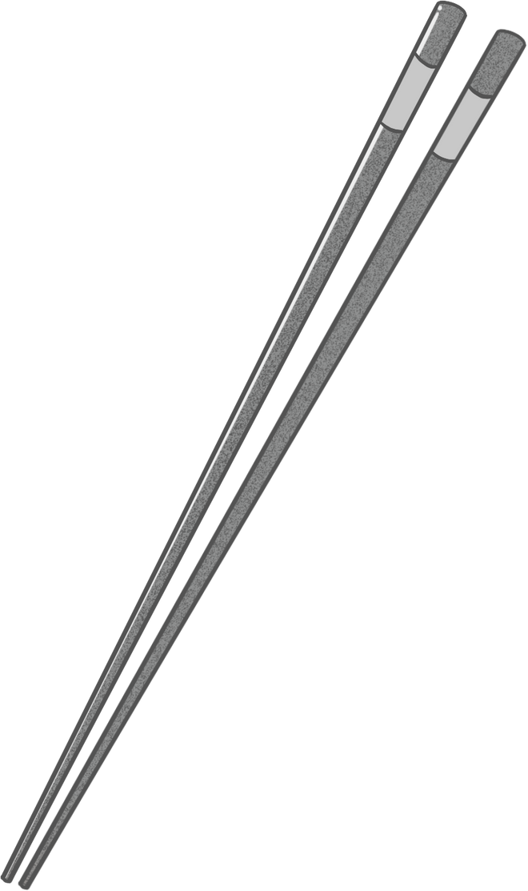


REASON
We choose to create a website about food ordering because it solves a real WORLD PROBLEM such as making it faster and easier for people to get their favorite meals. With busy lifestyles, convenience matters, and an online food ordering system helps both customers and food businesses save time and improve service.

Slide 7

ADVANTAGES
CONVENIENCE : Users can order their favorite Western meals anytime, anywhere without visiting the restaurant.
TIME SAVING : Fast online ordering reduces waiting time in queues.

Slide 8






CONCEPT

Slide 9


STORY
TARGET AUDIENCE
We created this website because we noticed many people love Western food but struggle with long queues or limited ordering options. Our inspiration came from the growing demand for quick online services, especially for meals like burgers, steaks, and pasta.
Our primary users are busy students, workers, and Western food lovers who prefer ordering online rather than dining out. The website fulfills the need for convenience, speed, and variety in Western cuisine.

Slide 10








DEVELOPMENT

Slide 11


TOOLS & TECHNOLOGIES
HTML, CSS for layout and styling
JavaScript for interactivity
PHP & MySQL for database and server-side processing
KEY FEATURES
User-friendly food menu with pictures and prices
Add to cart and order summary
Delivery or pickup options
Secure order form and confirmation page

Slide 12

ENHANCEMENT
In the future, we plan to add features like real-time order tracking, and online payment to further improve the user experience.

Slide 13


QR CODE/ LINK
https://huient901.github.io/Hahaha_Western_Food/index.html

Slide 14







TUTORIAL

Slide 15

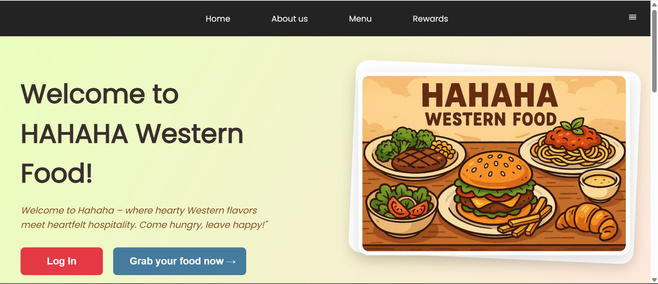

HOME PAGE
Click the log in button to login
or

Slide 16
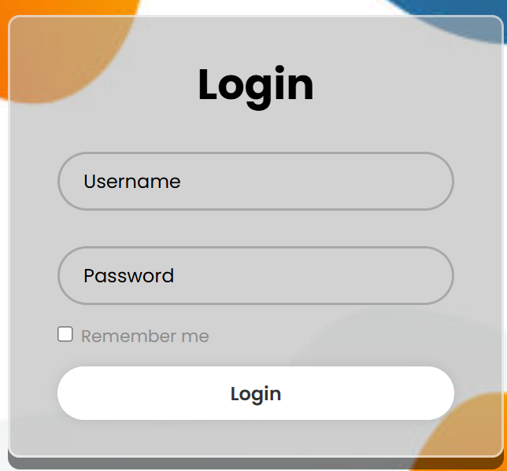
LOGIN PAGE
Key in your usename and password to login
Admin :
user: admin
password: 12342

Slide 17
HOME PAGE
Click “About us” to lookforward more information about Hahaha Restaurant

Slide 18
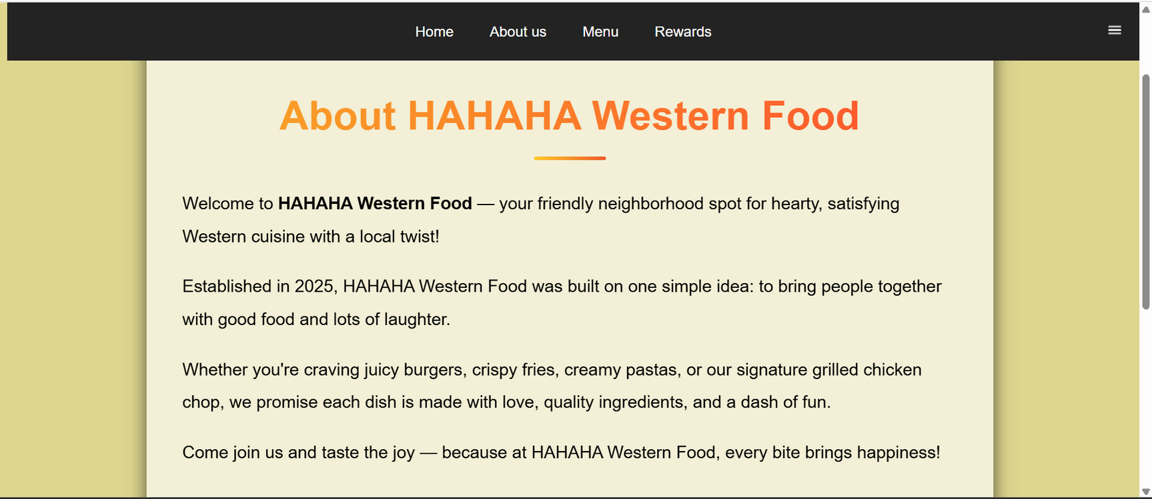
ABOUT US

Slide 19
HOME PAGE
After logging in, click “Grab your food now” to order food

Slide 20
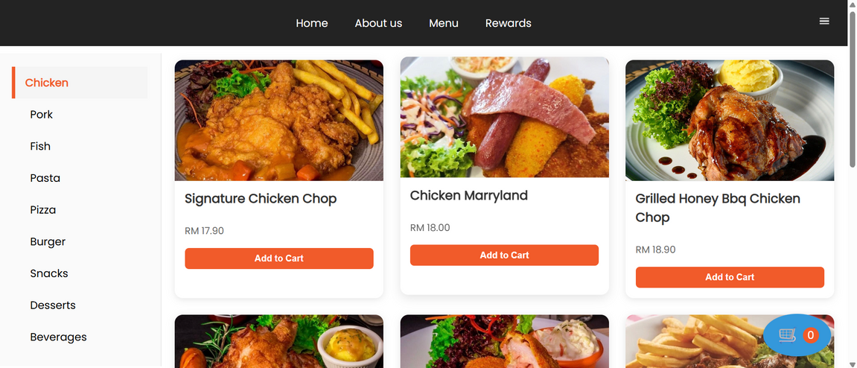
MENU
🔍Click the food that you want and add to cart

Slide 21
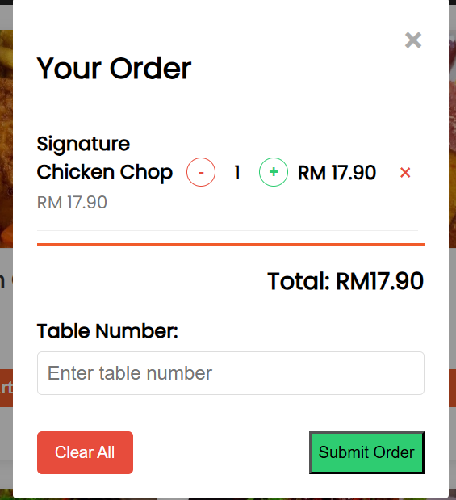
ORDER
When your food is added to card, click the trolley icon and submit order to order your food

Slide 22
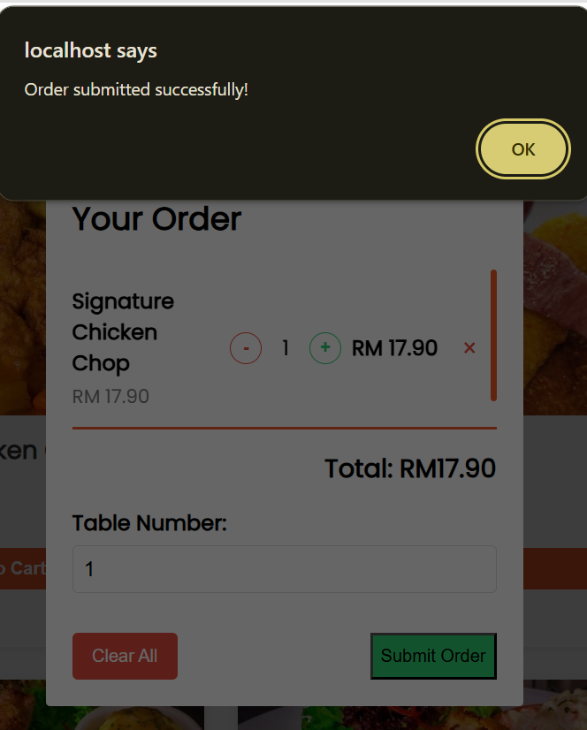
ORDER
Your order has been recorded

Slide 23
HOME PAGE
Click “Rewards” to see the reward requirements and join the Rewards Club.

Slide 24
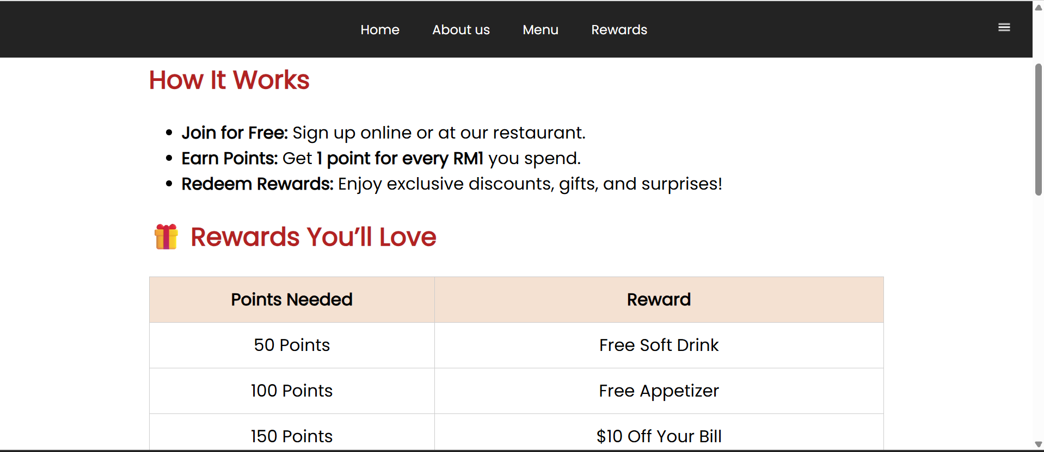
REWARDS

Slide 25
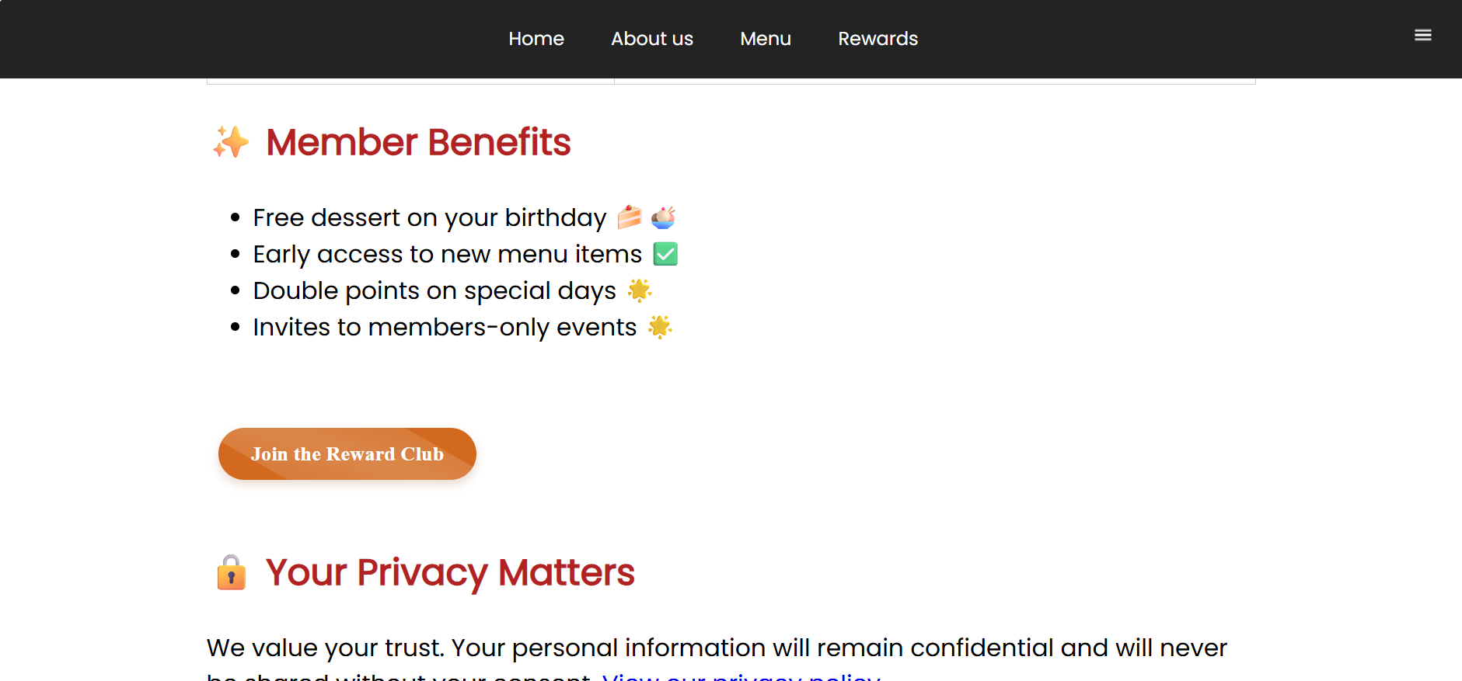
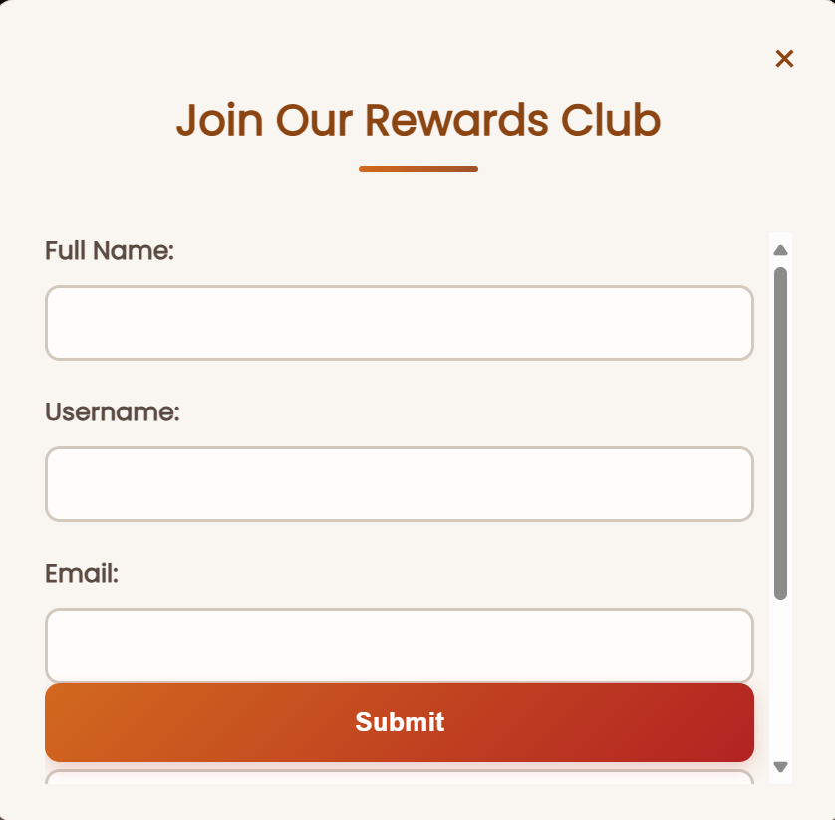


REWARDS
Enter your details and then submit to join the club.

Slide 26


Thank you for your attention

